Slide 1

Anticoagulation in Postpartum
Dr. Hantoushzadeh
Vali-E-Asr Reproductive Health Research Center

Slide 2

INTRODUCTION
Anticoagulation is sometimes needed during pregnancy and/or the postpartum period, including individuals at high risk of deep vein thrombosis, a history of venous thromboembolism, with prosthetic heart valves, atrial fibrillation, left ventricular dysfunction, or a history of fetal loss.
Use of anticoagulants during pregnancy is challenging due to the potential teratogenic effects and dosing complexities of the various agents, and the management of anticoagulation around the time of labor.

Slide 3
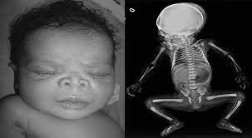
In addition, individuals receiving chronic anticoagulation who are contemplating pregnancy need counseling regarding how to avoid the potential teratogenic effects of warfarin and the passage of some of the anticoagulants to the fetus.
In contrast to anticoagulation of nonpregnant individuals, the choice of anticoagulant during pregnancy needs to take into account fetal safety and maternal peripartum issues including the unpredictable onset of labor and the use of neuraxial anesthesia for management of labor pain.

Slide 4
Heparins in Pregnancy
Low molecular weight (LMW) heparins – We recommend LMW heparin rather than unfractionated heparin for all but the final weeks of the pregnancy, because LMW heparins are effective and easier to administer than unfractionated heparin.
LMW heparins produce a more predictable anticoagulant response than unfractionated heparin and do not require routine monitoring.
The incidence of developing heparin-induced thrombocytopenia (HIT) is also less with LMW heparin than unfractionated heparin.
Unfractionated heparin – Unfractionated heparin is a reasonable alternative to a LMW heparin when cost or need for rapid reversal is important (eg, for delivery or perioperatively).
Unfractionated heparin is preferred over LMW heparin in individuals with severely reduced kidney function (creatinine clearance <30 mL/min) because LMW heparin clearance is almost exclusively by the kidney, while elimination of unfractionated heparin is by the kidney and liver.
Fondaparinux, argatroban, danaparoid – There is less information on the fetal effects of these agents, but available evidence suggests they are reasonable options.
Fondaparinux is preferred for individuals with a history of HIT (or active HIT).
Argatroban is most likely to cross the placenta.

Slide 5
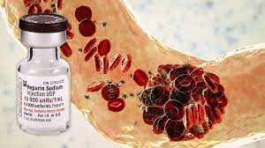
POSTPARTUM PERIOD
Resuming or initiating anticoagulation postpartum — Anticoagulation is reinstituted following delivery in most patients who were receiving an anticoagulant during pregnancy.
A possible exception is patients who received anticoagulation to prevent miscarriage or fetal loss.

Slide 6
Acute VTE (therapeutic dosing)
For acute venous thromboembolism (VTE) still in the active treatment period (first three months) or other indications requiring continuous anticoagulation (eg, high-risk thrombophilia), either unfractionated heparin or low molecular weight (LMW) heparin can be given alone at therapeutic doses.
or one of these anticoagulants should be administered during the initiation of warfarin and continued for a minimum of five days and an additional one to two days after an appropriate International Normalized Ratio (INR) has been obtained.

Slide 7
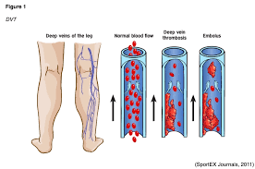
Acute VTE confers the highest risk for VTE recurrence, progression, or complications, and the risk-benefit calculation favors initiation of heparin as early as safely possible.
The ideal time to start anticoagulation after delivery is based on clinical judgment, as comparative data are very limited.
Unfractionated heparin or LMW heparin are generally resumed four to six hours after vaginal delivery or 6 to 12 hours after cesarean delivery, unless there was significant postpartum bleeding or traumatic neuraxial catheter placement

Slide 8
EVIDENCE
A retrospective study reported that bleeding rates were lower when more time elapsed following delivery (≥9.25 hours for vaginal and ≥15.1 hours for cesarean).
However, bleeding rates in a matched control group not receiving anticoagulation were not provided, co-interventions may have differed among groups, and the confidence intervals were wide and overlapping.
Major factors to consider in deciding when to restart anticoagulation include the underlying indication for anticoagulation (such as acute treatment of VTE versus prophylaxis) and other risk factors for bleeding.
Heparin can be transitioned to warfarin, fondaparinux, or danaparoid or, if not breastfeeding, to a direct oral anticoagulant if appropriate

Slide 9
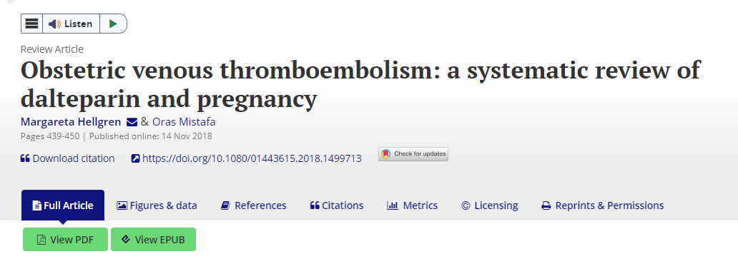

Slide 10
A therapeutic dosing throughout pregnancy or followed by reduced doses effectively prevented VTE recurrence.
Anti-factor Xa activity was the most commonly used method of dose monitoring. The risk of bleeding with dalteparin was generally minor.
Major bleeding was observed when a high dose of dalteparin was employed during (or close to) delivery, or postpartum.
Other adverse events were minor.
Disparity exists in VTE treatment and thromboprophylaxis, with wide variety in the dosing regimens, treatment strategies and monitoring practices employed.
Large randomised controlled trials are warranted but due to ethical reasons, and the rarity of VTE-associated obstetric complications, case-control, registry and large observational studies present more likely options.

Slide 11
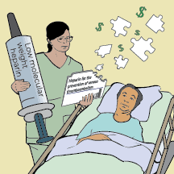
VTE prophylaxis
Additional patients who were not receiving anticoagulation during pregnancy may initiate it postpartum for VTE prevention (eg, inherited or acquired thrombophilia or prior VTE).
The urgency of starting heparin is less than for acute VTE (or VTE within the prior three months).
We initiate prophylactic doses of unfractionated heparin or LMW heparin 6 to 12 hours after vaginal delivery and 12 to 24 hours after cesarean delivery.

Slide 12

In a review of 95 individuals treated with postpartum anticoagulation, mostly at prophylactic doses, we found very few cases of bleeding, with the exception of two incisional hematomas in following cesarean delivery in individuals who received enoxaparin within 24 hours following delivery.
If oral anticoagulation is chosen for continued postpartum thromboprophylaxis, warfarin can be started immediately after delivery; unfractionated or LMW heparin can be discontinued when a therapeutic INR has been obtained if the patient is not at very high risk for thrombotic complication

Slide 13

Duration of postpartum anticoagulation
The duration of postpartum anticoagulation depends upon the underlying reason for anticoagulation.
Anticoagulation for VTE prophylaxis should be continued for at least six weeks postpartum, due to the continued high risk of VTE in the early postpartum period.

Slide 14
Thromboprophylaxis after delivery (RCOG)
All women with class 3 obesity (BMI greater than or equal to 40 kg/m2) should be considered for prophylactic LMWH in doses appropriate for their weight for 10 days after delivery.
Women with two or more persisting risk factors listed in Table 1 should be considered for LMWH in prophylactic doses appropriate for their weight for 10 days after delivery.
All women with a previous history of confirmed VTE should be offered thromboprophylaxis with LMWH or warfarin for at least 6 weeks postpartum regardless of the mode of delivery.

Slide 15
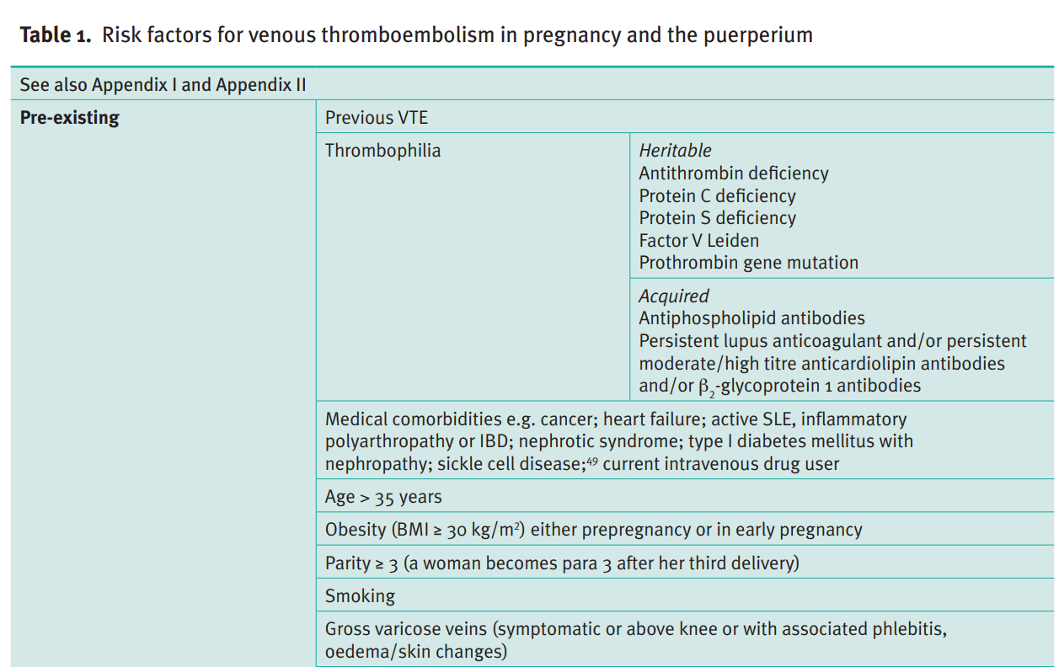

Slide 16
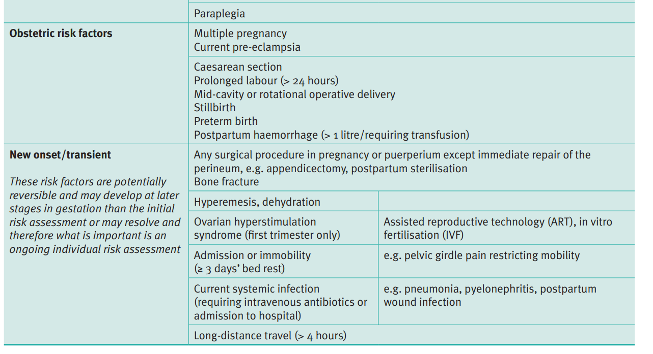

Slide 17
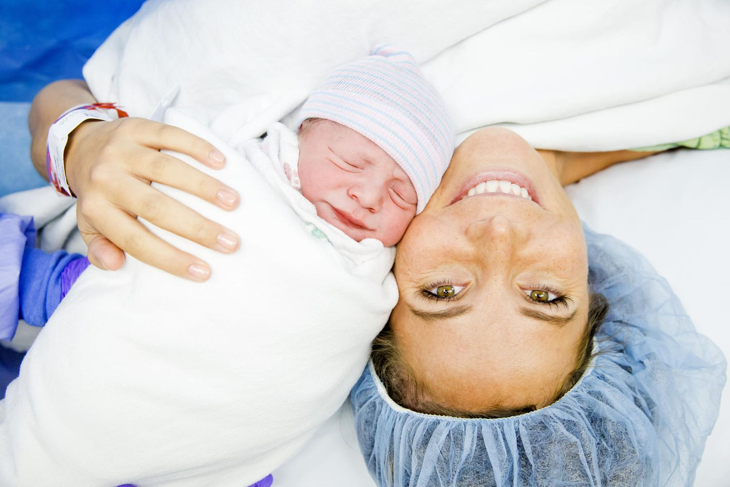
Women with thrombophilia without previous VTE should be stratified according to both the level of risk associated with their thrombophilia and the presence or absence of a family history or other risk factors.
Women with a family history of VTE and an identified thrombophilia should be considered for 6 weeks’ postnatal thromboprophylaxis.
All women who have had caesarean sections should be considered for thromboprophylaxis with LMWH for 10 days after delivery apart from those having an elective caesarean section who should be considered for thromboprophylaxis with LMWH for 10 days after delivery if they have any additional risk factors

Slide 18
LMWHs are the agents of choice for antenatal and postnatal thromboprophylaxis.
Doses of LMWH are based on weight.
For thromboprophylaxis the booking or most recent weight can be used to guide dosing.
It is only necessary to monitor the platelet count if the woman has had prior exposure to unfractionated heparin (UFH).
Monitoring of anti-Xa levels is not required when LMWH is used for thromboprophylaxis.
Doses of LMWH should be reduced in women with renal impairment.
LMWH is safe in breastfeeding.

Slide 19
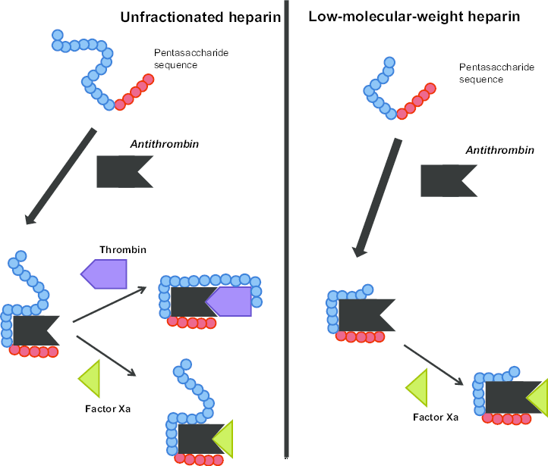
Unfractionated heparin
In women at very high risk of thrombosis (see Appendix IV), UFH may be used peripartum in preference to LMWH where there is an increased risk of haemorrhage or where regional anaesthetic techniques may be required.
If UFH is used after caesarean section (or other surgery), the platelet count should be monitored every 2–3 days from days 4–14 or until heparin is stopped.

Slide 20

Potential use of danaparoid should be in conjunction with a consultant haematologist with expertise in haemostasis and pregnancy.
Fondaparinux should be reserved for women intolerant of heparin compounds.
Fondaparinux use in pregnancy should be in conjunction with a consultant haematologist with expertise in haemostasis and pregnancy.
Aspirin is not recommended for thromboprophylaxis in obstetric patients.

Slide 21

Warfarin use in pregnancy is restricted to the few situations where heparin is considered unsuitable,
e.g. some women with mechanical heart valves.
Women receiving long-term anticoagulation with warfarin can be converted from LMWH to warfarin postpartum when the risk of haemorrhage is reduced, usually 5–7 days after delivery.

Slide 22
Anti-embolism stockings
The use of properly applied anti-embolism stockings (AES) of appropriate size and providing graduated compression with a calf pressure of 14–15 mmHg is recommended in pregnancy and the puerperium for women who are hospitalised and have a contraindication to LMWH.
These include women who are hospitalised post-caesarean section (combined with LMWH) and considered to be at particularly high risk of VTE (e.g. previous VTE, more than four risk factors antenatally or more than two risk factors postnatally) and women travelling long distance for more than 4 hours.

Slide 23

Contraindications to LMWH
LMWH should be avoided, discontinued or postponed in women at risk of bleeding after careful consideration of the balance of risks of bleeding and thrombosis.
Women with previous or current allergic reactions to LMWH should be offered an alternative preparation or alternative form of prophylaxis.
Further advice on the management of a woman with both VTE risk factors and bleeding risk factors or LMWH allergy may be sought from a haematologist with expertise in the management of thrombosis and bleeding disorders in pregnancy.

Slide 24
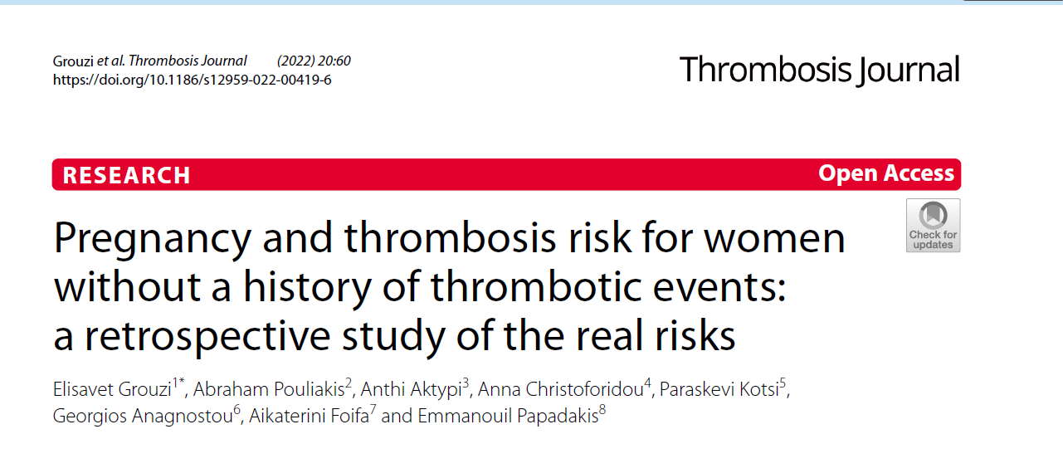

Slide 25
LMWHs are widely prescribed during pregnancy for a number of indications, even when a proven scientific basis for such a practice is lacking. However, a considerable percentage of women were already at VTE-risk according to PATrisks and might have derived an additional benefit from LMWH in the form of VTE prevention.
The rational use of these drugs should be optimized by establishing and implementing routine risk assessment for all pregnant women and by providing the necessary education to healthcare professionals.

